Slide 1

BCA Ist Semester
PROBLEM SOLVING USING COMPUTER
Course Code: BCAC 0018
Presented by:
Mr. SANTOSH KUMAR SWARNKAR
Dept. Of CEA
GLA University, Mathura

Slide 2
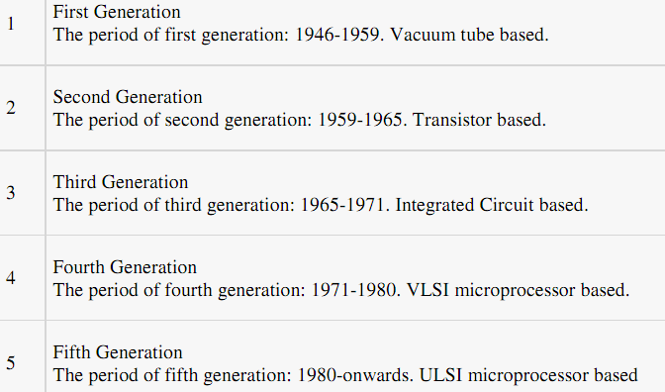
Generation of Computers

Slide 3
Third Generation (1965 to 1971):
Using Integrated Circuits
The third generation computers used the Integrated Circuit (IC) chips.
In an IC chip, multiple transistors are placed on a silicon chip.
The use of IC chip increased the speed and the efficiency of computer, very much.
The keyboard and monitor were used to interact with the third generation computer, instead of the punched card and printouts.

Slide 4
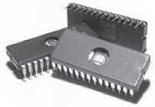
Figure 1.6 IC chips

Slide 5
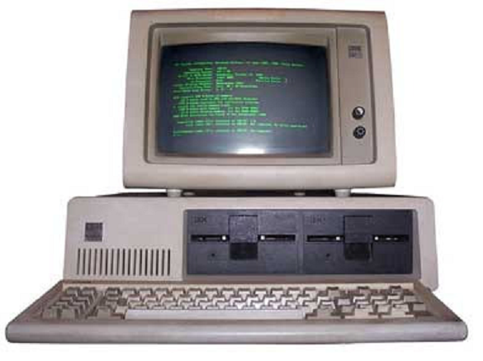

Slide 6
The keyboard and the monitor were interfaced through the operating system.
High-level languages were used extensively for programming, instead of machine language and assembly language.
IBM 370, PDP 11.

Slide 7
Fourth Generation (1971 to 1980):
Using Microprocessors
They use the Large Scale Integration (LSI) and the Very Large Scale Integration (VLSI) technology.
Thousands of transistors are integrated on a small silicon chip using LSI technology.
VLSI allows hundreds of thousands of components to be integrated in a small chip, called microprocessor.
Microprocessor is a chip containing millions of transistors and components, and, designed using LSI and VLSI technology.

Slide 8
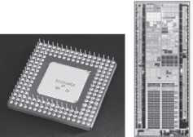
Figure 1.7 Microprocessors

Slide 9
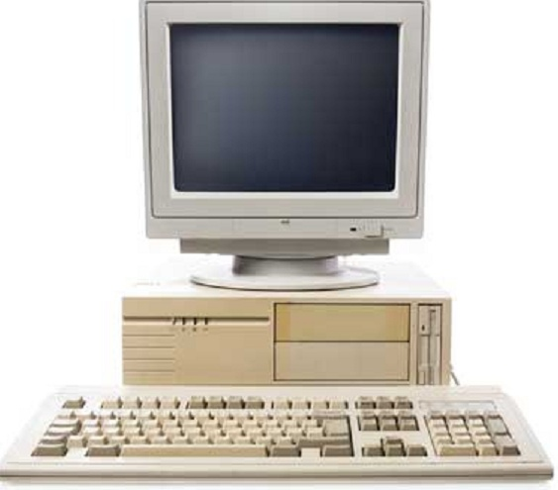

Slide 10
The computers were linked to form networks that led to the emergence of the Internet.
Several new operating systems like the MS-DOS and MS-Windows developed during this time.
This generation of computers supported Graphical User Interface (GUI).
GUI is a user-friendly interface that allows user to interact with the computer via menus and icons.
High-level programming languages are used for the writing of programs.
Examples : The Intel 4004 chip was the first microprocessor. The components of the computer like Central Processing Unit (CPU) and memory were located on a single chip.In 1981, IBM introduced the first computer for home use. In 1984, Apple introduced theMacintosh.

Slide 11
Fifth Generation (1980 Onwards..):
Using Artificial Intelligence
The goal of fifth generation computing is to develop computers that are capable of learning and self-organization.
The fifth generation computers use Super Large Scale Integrated (SLSI) chips that are able to store millions of components on a single chip.
This generation of computers uses parallel processing that allows several instructions to be executed in parallel, instead of serial execution.
Parallel processing results in faster processing speed.

Slide 12
The fifth generation computers are based on Artificial Intelligence (AI).
They try to simulate the human way of thinking and reasoning.
Artificial Intelligence includes areas like Expert System (ES), Natural Language Processing (NLP), speech recognition, voice recognition, robotics, etc.

Slide 13
THANK YOU

